Slide 1
CVD Training

Slide 2
agenda
Goal: Create a shared understanding of Core Value Drivers (CVDs) by highlighting key topics and resurfacing available resources.
HR CVD Overview
Decoding the CVD Bowler
Annualizing & Forecasting

Slide 3
HR Core Value Drivers (CVDs)
HR Analytics SharePoint | CVD Metrics | CVD Guide & FAQ | CVD Bowlers Template
 | Internal Fill Rate | Professional Voluntary Turnover | Manufacturing Voluntary Turnover
Definition | Percentage of M1+ level roles that are filled internally | Turnover rate for professional and above associates that leave the company voluntarily. | Turnover rate for direct and indirect labor associates that leave the company voluntarily
Population | Supervisor+ (by career level) Employees only (no contingent) HR is removed | All career levels, excluding DL/IDL Employees only (no contingent) HR is removed | DL/IDL Only Employees only (no contingent) HR is removed
Goal | 50% | 10% Improvement from 2024 | Set by business
Audience | L1 (Segment/POR) L2 (Division/BUR) L3 (Plant/SOR) | L1 (Segment/POR) L2 (Division/BUR) L3 (Plant/SOR) | L3 (Plant/SOR)
Primary Metric | YTD | Annualized YTD | Annualized YTD
Forecasting Guidance | YTD | Annualized YTD / 12 | Annualized YTD / 12
Still need help? Start here

Slide 4
Cvd metric populations
Career Level | Career Level Bucket | Internal Fill | Professional Turnover | Manufacturing Turnover
E2 to E5 | VP | X | X
M5 to E1 | Director | X | X
M2 to M4 | Manager | X | X
M1 | Supervisor | X | X
P1 to P6 | Professional |  | X
AT1 to AT4 | Admin/ Technical |  | X
None | DL/IDL |  |  | X

Slide 5
Where is the data coming from?
These metrics are based on an Active and Terminated data file from Talent Hub (Workday). That means that the calculations are based on the data that is in Workday today or at the time of termination.
The data is pulled monthly, effective the first of the month.
Each update, the data is re-run for the full year.
This means:
Previous month data can change
Retroactive entries are captured
Data corrections are reflected
 | Talent Hub (Workday) | HR Analytics SharePoint | Future State: Power BI
Purpose | Raw Data Source | Standard Reporting | Insights
Intent | Source of truth | Static metric reporting | Dive deeper into metrics to understand drivers
HR Accountability | Regularly review data for accuracy (e.g., segment assignment) and pull reports for ad-hoc needs | Be prepared to speak to CVD metrics at BURs | Utilize the tool to uncover drivers, hotspots, and trends

Slide 6
Decoding the bowler

Slide 7
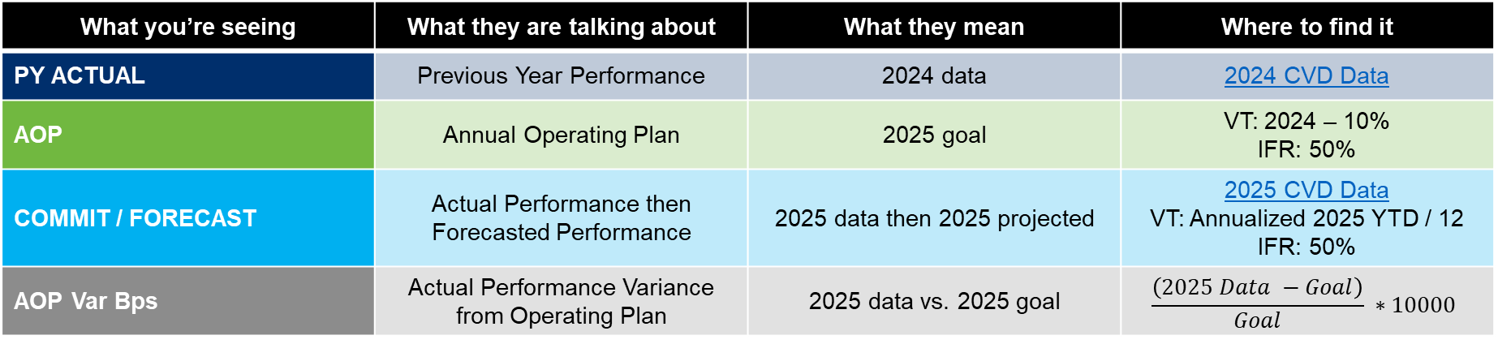
Decoding the cvd bowler
CVD | KPI | YTD | 2025 | Jan | Feb | Mar | Q1 | Apr | … | FY
Professional Turnover | Voluntary Turnover Professional % .0 |  | PY ACTUAL
 |  |  | AOP
 |  |  | COMMIT / FORECAST
 |  |  | AOP Var Bps
What you’re seeing | What they are talking about | What they mean | Where to find it
PY ACTUAL | Previous Year Performance | 2024 data | 2024 CVD Data
AOP | Annual Operating Plan | 2025 goal | VT: 2024 – 10% IFR: 50%
COMMIT / FORECAST | Actual Performance then Forecasted Performance | 2025 data then 2025 projected | 2025 CVD Data VT: Annualized 2025 YTD / 12 IFR: 50%
AOP Var Bps | Actual Performance Variance from Operating Plan | 2025 data vs. 2025 goal | $$\frac{\left(2025 Data −Goal\right)}{Goal} ∗10000$$
VT = Voluntary Turnover
IFR = Internal Fill Rate

Slide 8
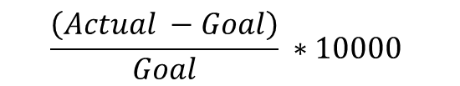
What is a basis point?
Finance often works with tiny numbers where even a one hundredth of a percent can make a big difference.
A basis point (bps) is a unit of measure used in finance to describe the change in a percent.
1 basis point = 0.01% (1 hundredth of a percent)
100 basis points = 1%
Example: If mortgage rates increase from 6.88% to 6.90%, it increased by 2 basis points (or 0.02%).
Note: The bowler uses relative basis points change
$$\frac{\left(Actual −Goal\right)}{Goal} ∗10000$$
Metric | 1% → 2% | 50% → 51%
Absolute change (%) | 1% | 1%
Absolute change (bps) | 100 bps | 100 bps
Relative change (%) | 100% | 2%
Relative change (bps) | 10,000 bps | 200 bps

Slide 9
Annualizing & forecasting

Slide 10

Annualizing and forecasting Voluntary Turnover
YTD Annualized: Projected year-end results based on current year-to-date performance
Monthly Forecast: Prorated projected year-end results
If I read 6 books in the first quarter, and I continue at my current pace, I am projected to read 24 books this year. This means an average of 2 books per month.
YTD: 6 Annualized: 24
Monthly Forecast: 2
Q1 |  |  | Q2 |  |  | Q3 |  |  | Q4
Jan | Feb | Mar | Apr | May | June | July | Aug | Sep | Oct | Nov | Dec
3 | 1 | 2 | 2 | 2 | 2 | 2 | 2 | 2 | 2 | 2 | 2
YTD
* $\left(\frac{12}{Current Month}\right)$ = YTD Annualized
÷ 12 = Monthly Forecast
This is only for voluntary turnover, not internal fill

Slide 11


Why annualize turnover and not internal fill?
Turnover |  | Internal Fill
Rainfall If you know how much it rains in a month, you can estimate how much it will rain in a year |  | Purple Umbrellas If 1 out of 10 people use a purple umbrella, you can’t estimate how many purple umbrellas you’ll see. Depends on the weather, how many total people there are, etc.

Slide 12


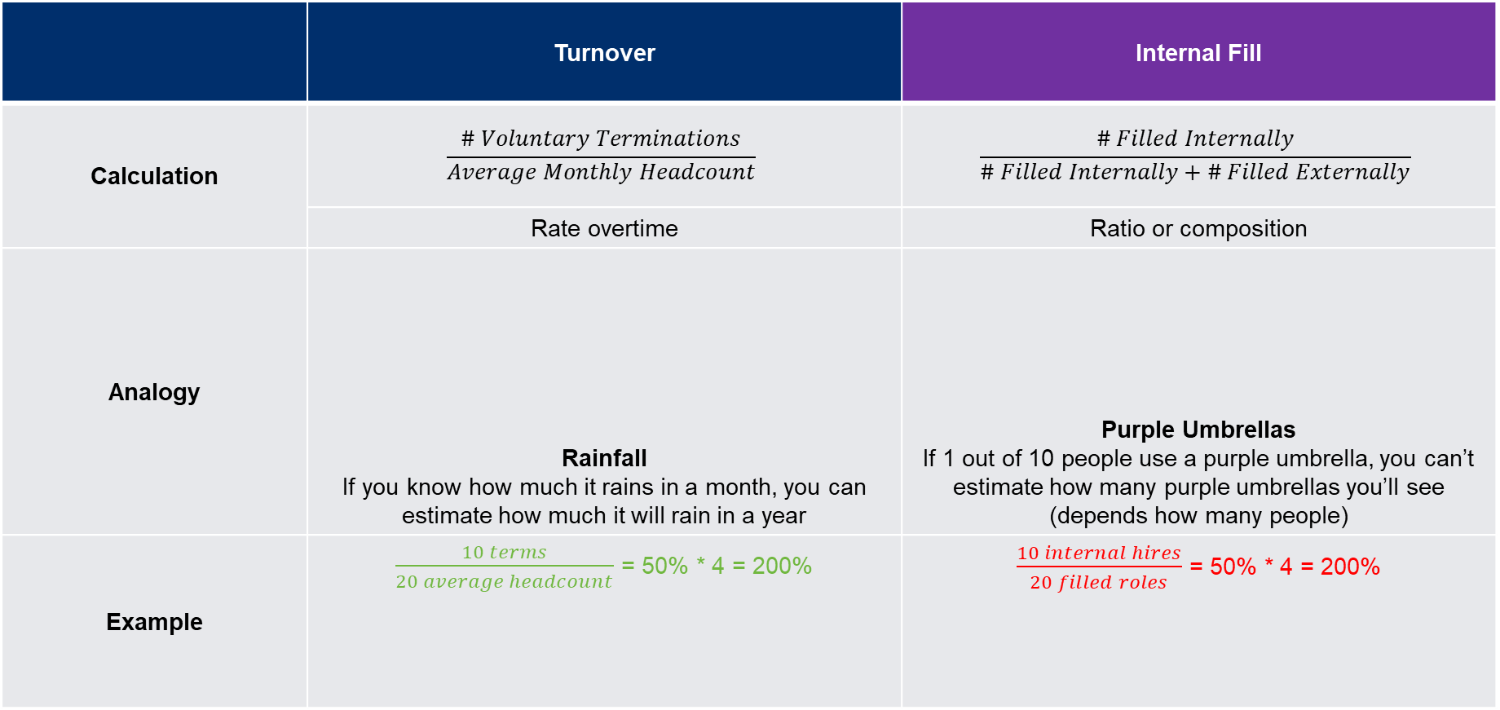
Why annualize turnover and not internal fill?
 | Turnover | Internal Fill
Calculation | $$\frac{\# Voluntary Terminations}{Average Monthly Headcount}$$ | $$\frac{\# Filled Internally}{\# Filled Internally+\# Filled Externally}$$
 | Rate overtime | Ratio or composition
Analogy | Rainfall If you know how much it rains in a month, you can estimate how much it will rain in a year | Purple Umbrellas If 1 out of 10 people use a purple umbrella, you can’t estimate how many purple umbrellas you’ll see (depends how many people)
Example | $\frac{10 terms}{20 average headcount}$ = 50% * 4 = 200% | $\frac{10 internal hires}{20 filled roles}$ = 50% * 4 = 200%

Slide 13
appendix

Slide 14

Bowler summary
CVD | KPI | YTD | 2025 | Jan | Feb | Mar | Q1 | Apr | … | FY
Professional Turnover | Voluntary Turnover Professional % .0 |  | PY ACTUAL
 |  |  | AOP
 |  |  | COMMIT / FORECAST
 |  |  | AOP Var %
YTD
* $\left(\frac{12}{Current Month}\right)$
YTD Annualized
÷ 12
Monthly Forecast

Slide 15
Bowler summary
CVD | KPI | YTD | 2025 | Jan
Professional Turnover | Voluntary Turnover Professional % .0 | YTD | PY ACTUAL | 2024 Actual
 |  |  | AOP | 2024 – 10%
 |  |  | COMMIT / Forecast | 2025 Actual / Annualized YTD / 12
 |  |  | AOP Var Bps | (2025 Actual – AOP) / AOP * 1000
Manufacturing Turnover | DL / IDL Voluntary Turnover % .0 | YTD | PY ACTUAL | 2024 Actual
 |  |  | AOP | Goal set by business
 |  |  | COMMIT / Forecast | 2025 Actual / Annualized YTD / 12
 |  |  | AOP Var Bps | (2025 Actual – AOP) / AOP * 1000
Leadership Roles Fill Rate | Internal Fill Rate Supervisor+ % .0 | YTD | PY ACTUAL | 2024 Actual
 |  |  | AOP | 50%
 |  |  | COMMIT / Forecast | 2025 Actual / 50%
 |  |  | AOP Var Bps | (2025 Actual – AOP) / AOP * 1000

Slide 16
Bowler guide
 | Levels | YTD | PY Actual | AOP | Commit | Forecast
Professional Voluntary Turnover | L1, L2, L3 | YTD | 2024 actual | 2024 – 10% | 2025 actual | Annualized YTD / 12
Manufacturing Voluntary Turnover | L3 only | YTD | 2024 actual | Goal set by business | 2025 actual | Annualized YTD / 12
Internal Fill Rate | L1, L2, L3 | YTD | 2024 actual | 50% | 2025 actual | 50%

